Slide 1
SINGULAR VALUE DECOMPOSITION

Slide 2
INTRODUCTION
Let A be any m x n matrix. Then there exist matrices U ∑ V ^{T} such that :
• ∑ is an m × n diagonal matrix with elements on the diagonal in descending order,
• V ^{T} is an n × n orthonormal matrix,
• U is an m × m orthonormal matrix,
A= U ∑ V ^{T}
Specifically the diagonal element of ∑ are the singular values of A, the row of V ^{T} are the right singular vectors, and the columns of U are the left singular vectors.
The expression of A as the product U . ∑ . V ^{T} is known as singular value decomposition of A

Slide 3
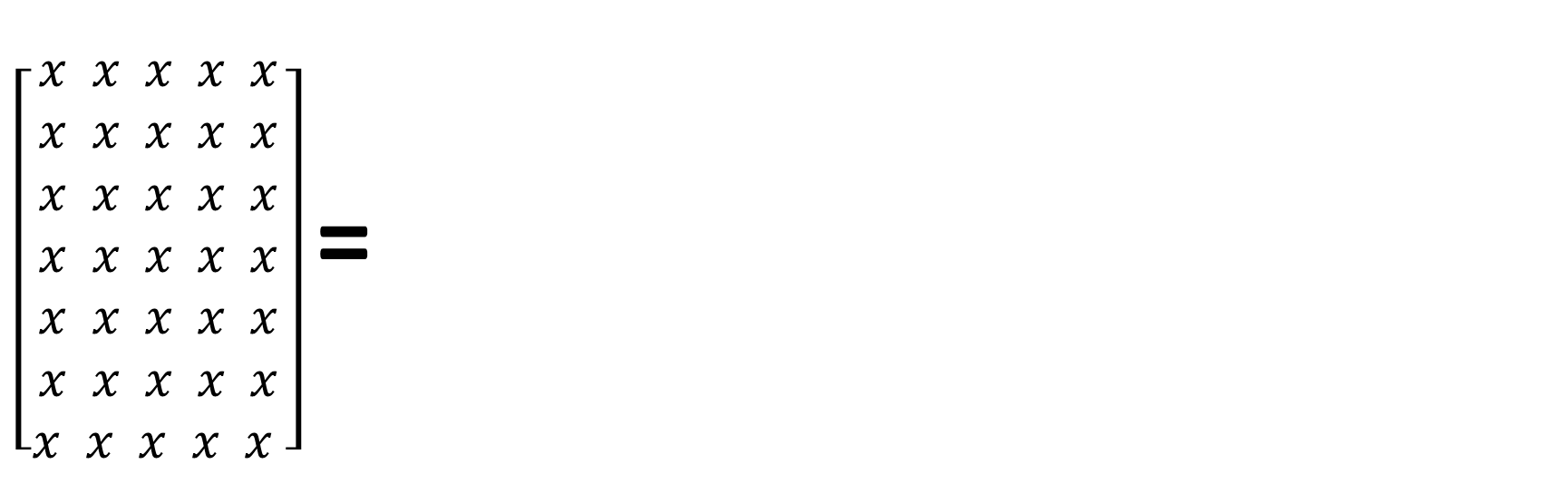
A = (orthogonal) (diagonal) (orthogonal)
$\left[\begin{aligned}x x x x x \\ x x x x x \\ x x x x x \\ x x x x x \\ x x x x x \\ x x x x x \\ x x x x x \end{aligned}\right]$ =
σ1
[]
[]
σr
U
V ^{T}
A= U ∑ V ^{T}
A = u₁σ₁v₁^{T}+u₂σ₂v₂^{T}+………..+u_{r}σ_{r}v_{r}^{T}

Slide 4
Properties of the SVD
Some properties of U, S, V are:
• U, ∑ , V provide a real-valued matrix factorization of A, i.e., A = U ∑ V^{T} .
• U is a m x n matrix with orthonormal columns, U^{T}U = I_{n}, where I_{n} is the
n × n identity matrix.
• V is an orthonormal k × k matrix, V^{T} = V ⁻¹.
• ∑ is a n × n diagonal matrix, with the non-negative singular values, σ1, σ2, σ3. . . . , σn, on the diagonal.
• By convention the singular values are given in the sorted order σ1 ≥ σ2 ≥ ….. ≥ σn ≥ 0.

Slide 5
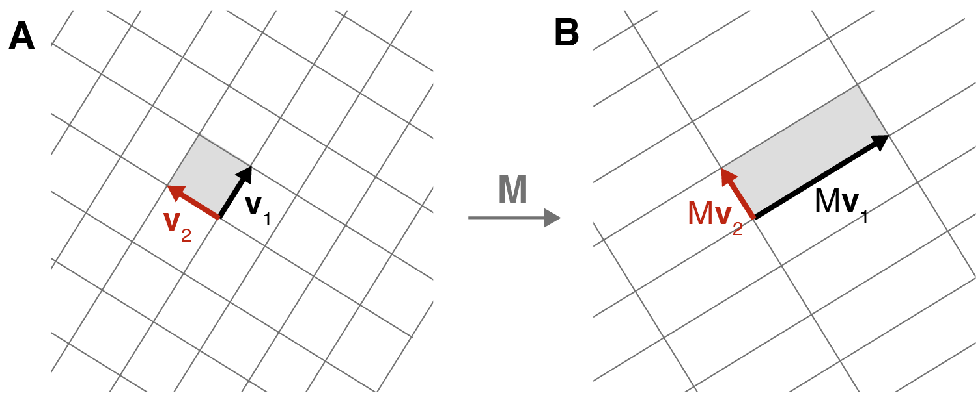
let’s call the orthogonal vectors in the input space v₁ and v₂ (Figure A). After applying a matrix transformation A to these two vectors, we get Av₁ and Av₂ (Figure B). Further more, let’s decompose these two transformed vectors into unit vectors, u₁ and u₂, times their respective magnitudes, σ₁ and σ₂. In other words:
Av₁=u₁σ₁
Av₂=u₂σ₂ (Eq^{n}--1)
A

Slide 6
We can do a little alzebric manipulation. First , note that any vector x can be described using the basis of vectors v₁ and v₂ in the following way,
x = (x. v₁) v₁ + (x. v₂) v₂ (3)
We are projecting , via the dot product, x onto v₁ and v₂, before decomposing the terms the using the basis vectors v₁ and v₂.
Next let’s left-multiply both sides of Equation (3) by our Matrix transformation A . Since the Dot-product produces a scalar, we can distribute and commute A as follow :
Ax=(x⋅v₁)Av₁+(x⋅v₂)Av₂
_{Next, we can rewrite} Av₁ as u₁σ_{1 :}
Ax=(x⋅v₁)u₁σ₁+(x⋅v₂) u₂σ₂
We are almost there. Now since the dot product is commutative, we can switch the ordering, e.g.
x.v₁ = x_{T}v₁=v₁^{T}x. And since each dot product term is a scalar, we move each one to the end of their respective expression :

Slide 7

Ax = u₁σ₁v₁^{T} x+u₂σ₂v₂^{T}x
Now we can move x from both the sides of the equation.
We get,
A = u₁σ₁v₁^{T}+u₂σ₂v₂^{T} (4)
Given appropriately defined matrices, Equation 4 becomes SVD in its canonical form(A=U∑V^{T}) for 2 x 2 matrices:
A = [u₁ u₂]$\left[\begin{matrix}σ1 & 0 \\ 0 & σ2\end{matrix}\right] \left[\begin{aligned}v1T \\ v2T\end{aligned}\right] (5)$
U
∑
V^{T}

Slide 8
Geometrical Interpretation of SVD
-Nidhi Sangwan

Slide 9
Transformations
Transformations on a plane or space can be seen as functions that take points to other points
Scaling
Stretch (or Compress) horizontally
Stretch (or Compress) vertically
Rotate
By rotating and scaling we can mimic every linear transformation

Slide 10
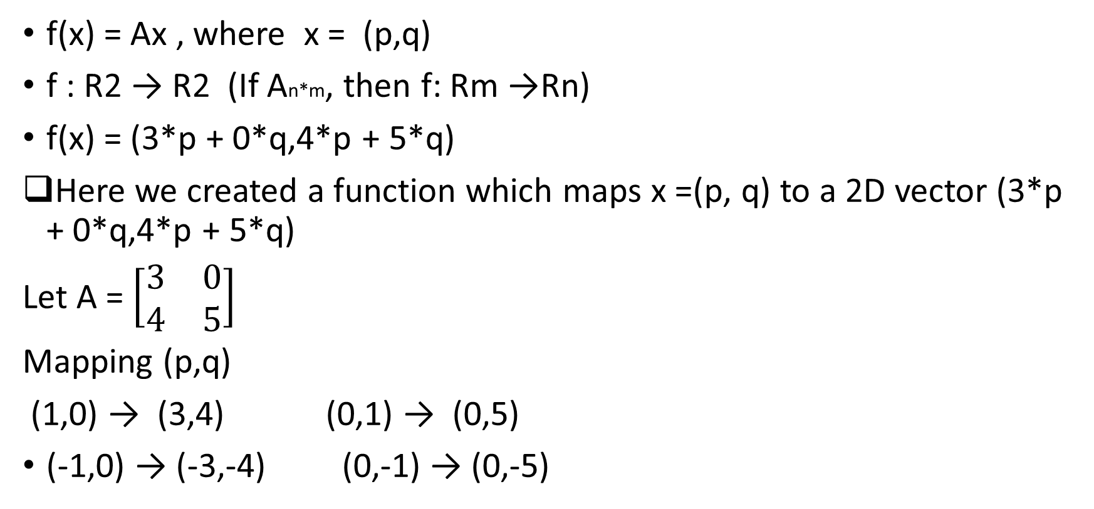
Linear transformations
f(x) = Ax , where x = (p,q)
f : R2 → R2 (If An*m, then f: Rm →Rn)
f(x) = (3*p + 0*q,4*p + 5*q)
Here we created a function which maps x =(p, q) to a 2D vector (3*p + 0*q,4*p + 5*q)
Let A = $\left[\begin{matrix}3 & 0 \\ 4 & 5\end{matrix}\right]$
Mapping (p,q)
(1,0) → (3,4) (0,1) → (0,5)
(-1,0) → (-3,-4) (0,-1) → (0,-5)

Slide 11
Linear transformation
(p,q)
(3*p + 0*q,4*p + 5*q)
The transformation turned unit circle into ellipse

Slide 12
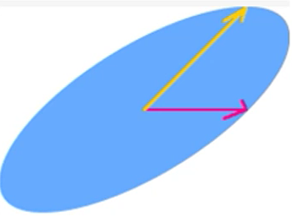
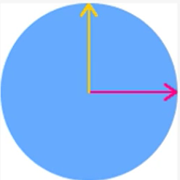
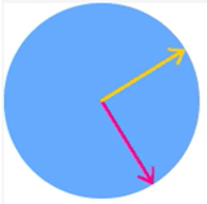
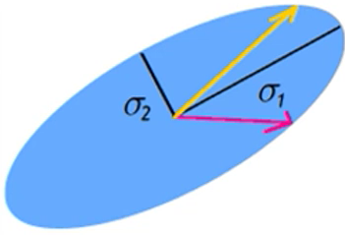
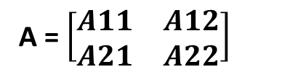
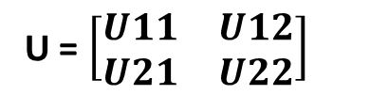
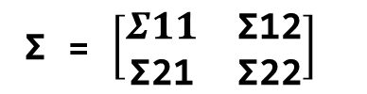
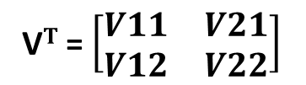
SVD
A = $\left[\begin{matrix}A11 & A12 \\ A21 & A22\end{matrix}\right]$
V$T$ = $\left[\begin{matrix}V11 & V21 \\ V12 & V22\end{matrix}\right]$
Σ = $\left[\begin{matrix}Σ11 & \text{Σ}\text{12} \\ \text{Σ}\text{21} & \text{Σ}\text{22}\end{matrix}\right]$
U = $\left[\begin{matrix}U11 & U12 \\ U21 & U22\end{matrix}\right]$

Slide 13
SVD is a method of decomposing matrix into other matrices A = UΣV*
import numpy as np
A = np.array([[3,0],[4,5]])
print(np.linalg.svd(A))
Matrix U:
array([[-0.31622777, -0.9486833 ], [-0.9486833 , 0.31622777]]
Diagonal entries of Σ :
array([6.70820393, 2.23606798])
Matrix Transpose(V):
array([[-0.70710678, -0.70710678], [-0.70710678, 0.70710678]]

Slide 14
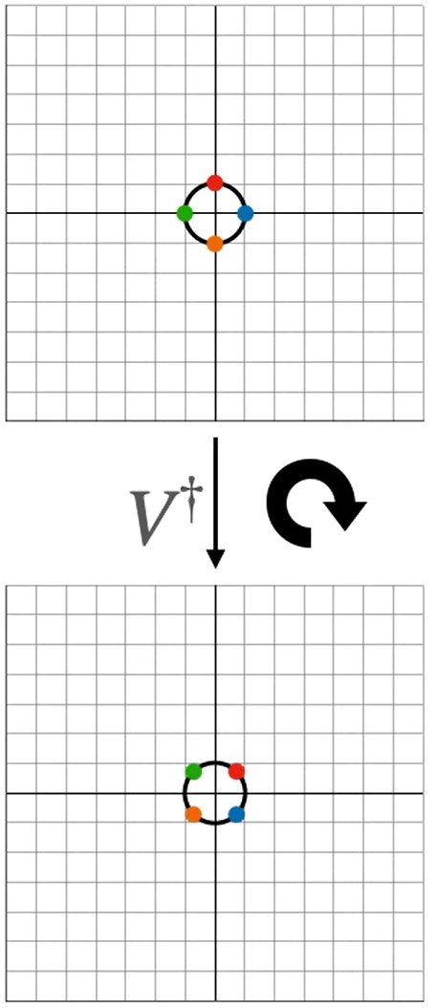
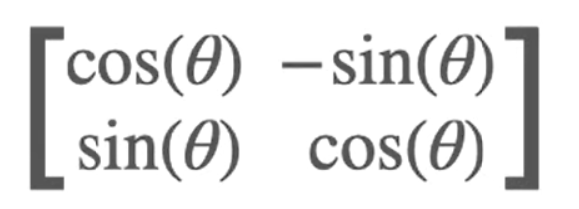
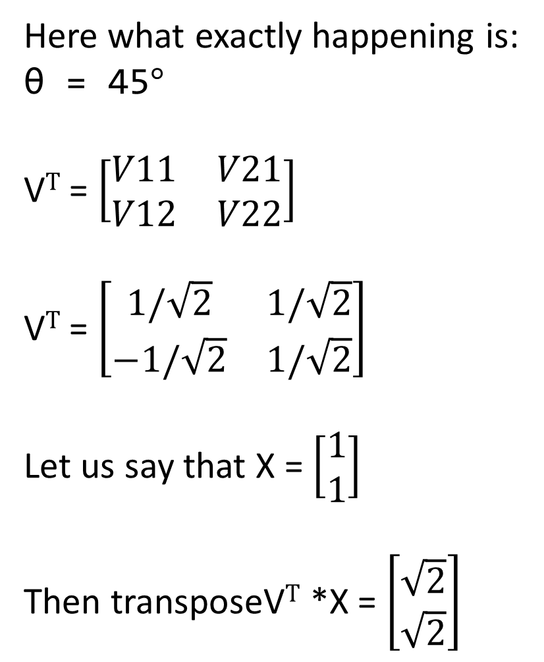
Here what exactly happening is:
θ = 45$°$
V$T$ = $\left[\begin{matrix}V11 & V21 \\ V12 & V22\end{matrix}\right]$
V$T$ = $\left[\begin{matrix}1/\sqrt{2} & 1/\sqrt{2} \\ −1/\sqrt{2} & 1/\sqrt{2}\end{matrix}\right]$
Let us say that X = $\left[\begin{aligned}1 \\ 1\end{aligned}\right]$
Then transposeV$T$ *X = $\left[\begin{aligned}\sqrt{2} \\ \sqrt{2}\end{aligned}\right]$

Slide 15
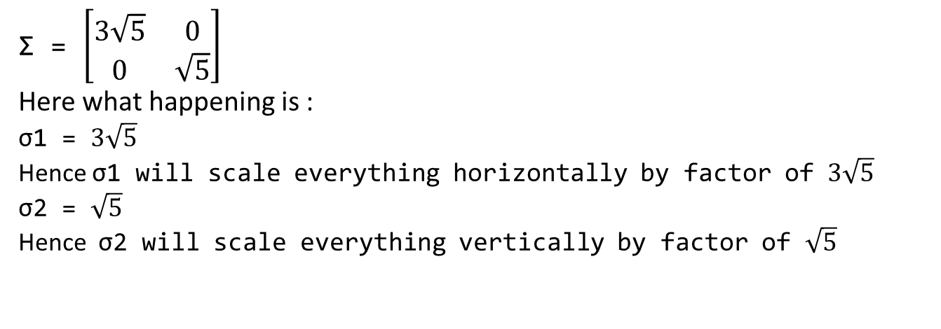
Σ = $\left[\begin{matrix}3\sqrt{5} & \text{0} \\ 0 & \sqrt{5}\end{matrix}\right]$
Here what happening is :
σ1 = $3\sqrt{5}$
Hence σ1 will scale everything horizontally by factor of $3\sqrt{5}$
σ2 = $\sqrt{5}$
Hence σ2 will scale everything vertically by factor of $\sqrt{5}$

Slide 16
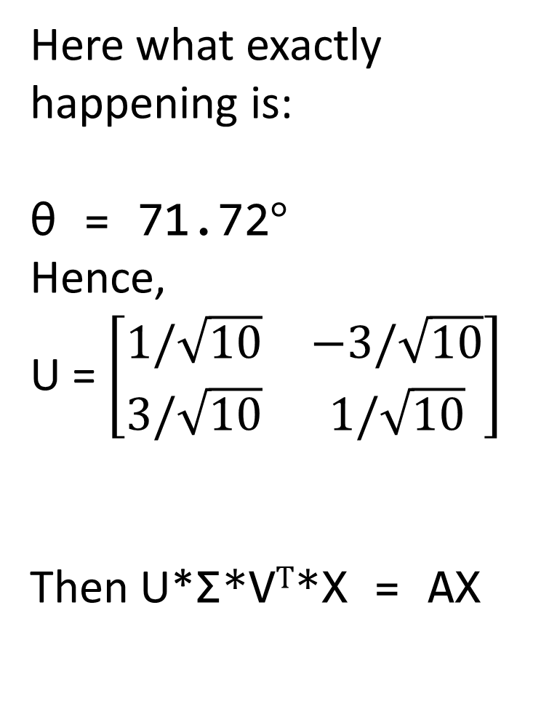
Here what exactly happening is:
θ = 71.72$°$
Hence,
U = $\left[\begin{matrix}1/\sqrt{10} & −3/\sqrt{10} \\ 3/\sqrt{10} & 1/\sqrt{10}\end{matrix}\right]$
Then U*Σ*V$T$*X = AX

Slide 17
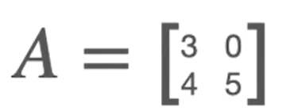
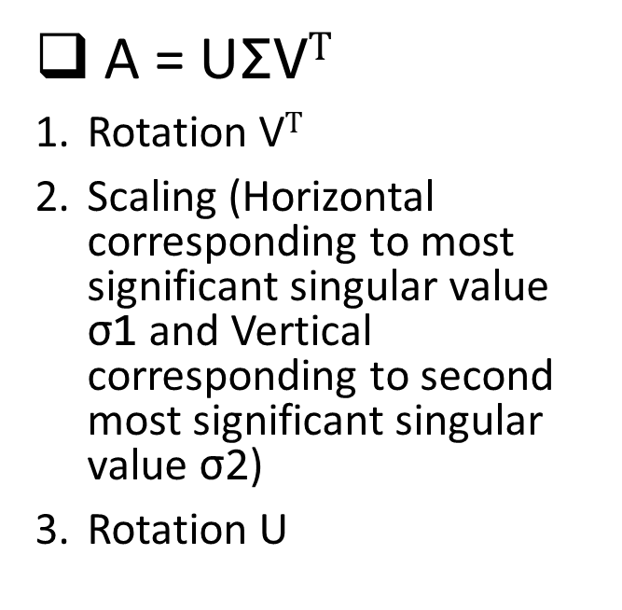
The transformation turned unit circle into ellipse
Summary
A = UΣV$T$
Rotation V$T$
Scaling (Horizontal corresponding to most significant singular value σ1 and Vertical corresponding to second most significant singular value σ2)
Rotation U

Slide 18
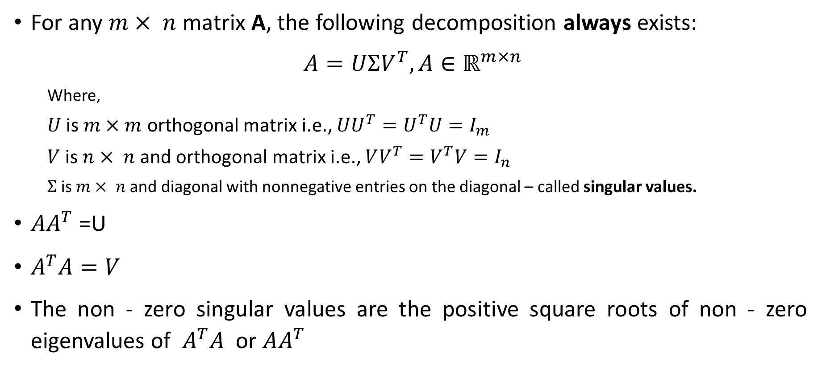
Singular value decomposition (SVD)
For any $m× n$ matrix A, the following decomposition always exists:
$A=UΣV^{T}, A∈ℝ^{m×n}$
Where,
$U$ is $m×m$ orthogonal matrix i.e., $UU^{T}=U^{T}U=I_{m}$
$V$ is $n× n$ and orthogonal matrix i.e., $VV^{T}=V^{T}V=I_{n}$
$Σ$ is $m× n$ and diagonal with nonnegative entries on the diagonal – called singular values.
$AA^{T}$ =U
$A^{T}A=V$
The non - zero singular values are the positive square roots of non - zero eigenvalues of $A^{T}A$ or $AA^{T}$

Slide 19
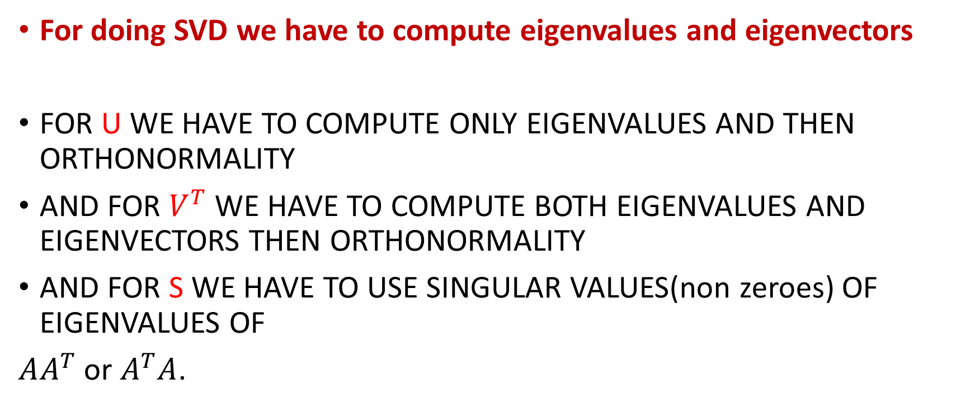
For doing SVD we have to compute eigenvalues and eigenvectors
FOR U WE HAVE TO COMPUTE ONLY EIGENVALUES AND THEN ORTHONORMALITY
AND FOR $V^{T}$ WE HAVE TO COMPUTE BOTH EIGENVALUES AND EIGENVECTORS THEN ORTHONORMALITY
AND FOR S WE HAVE TO USE SINGULAR VALUES(non zeroes) OF EIGENVALUES OF
$AA^{T}$ or $A^{T}A$.

Slide 20
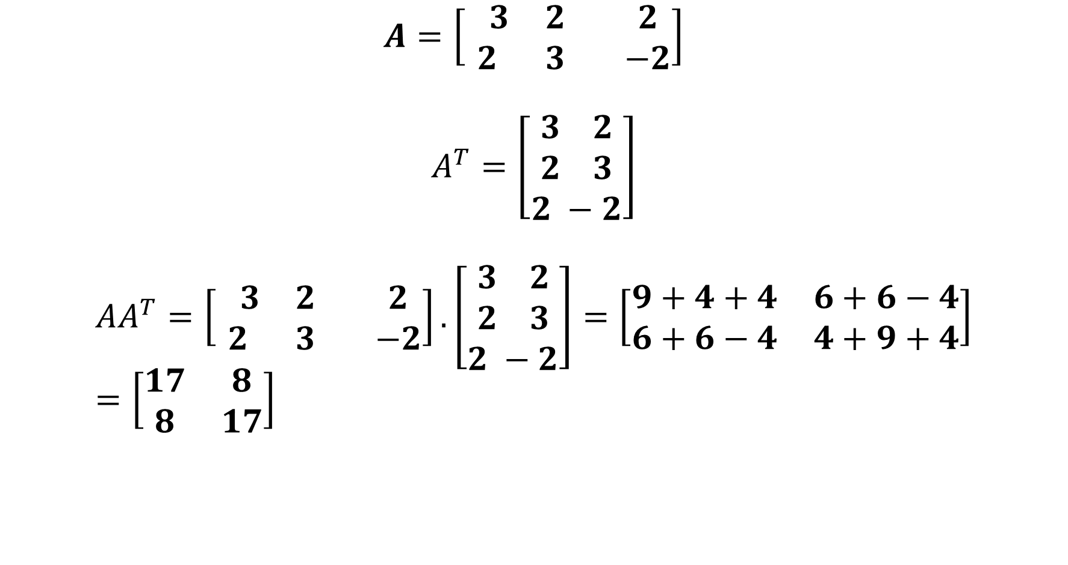
SVD Example
$$A=\left[\begin{matrix} 3 & 2 & 2 \\ 2 & 3 & −2\end{matrix}\right]$$
$$A^{T}=\left[\begin{aligned}3 2 \\ 2 3 \\ 2 −2\end{aligned}\right]$$
$$AA^{T}=\left[\begin{matrix} 3 & 2 & 2 \\ 2 & 3 & −2\end{matrix}\right].\left[\begin{aligned}3 2 \\ 2 3 \\ 2 −2\end{aligned}\right]=\left[\begin{matrix}9+4+4 & 6+6−4 \\ 6+6−4 & 4+9+4\end{matrix}\right]=\left[\begin{matrix}17 & 8 \\ 8 & 17\end{matrix}\right]$$

Slide 21
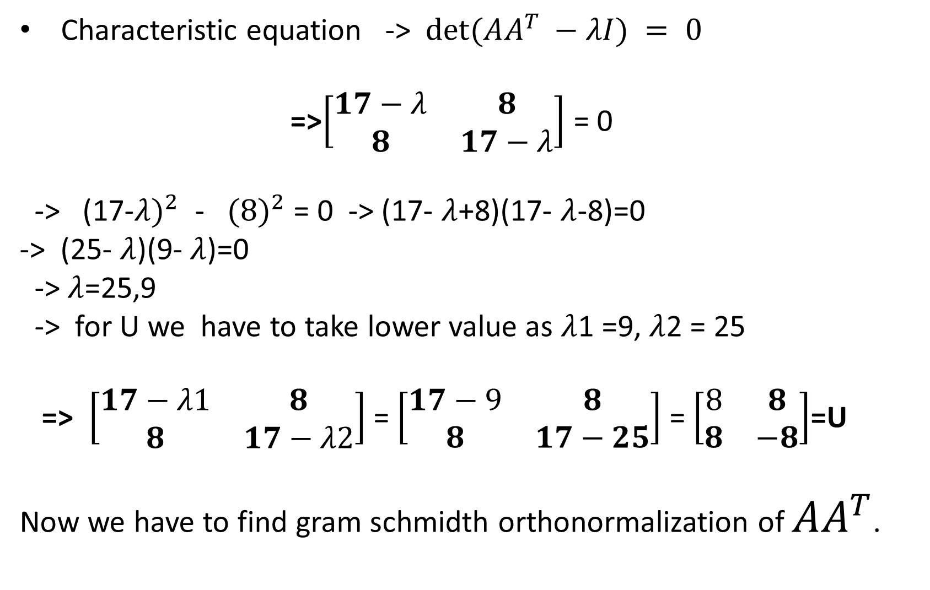
Characteristic equation -> $det⁡(AA^{T} −λI) = 0$
=>$\left[\begin{matrix}17−λ & 8 \\ 8 & 17−λ\end{matrix}\right]$ = 0
-> (17-${λ)}^{2}$ - ${(8)}^{2}$ = 0 -> (17- $λ$+8)(17- $λ$-8)=0
-> (25- $λ$)(9- $λ$)=0
-> $λ$=25,9
-> for U we have to take lower value as $λ$1 =9, $λ$2 = 25
=> $\left[\begin{matrix}17−λ1 & 8 \\ 8 & 17−λ2\end{matrix}\right]$ = $\left[\begin{matrix}17−9 & 8 \\ 8 & 17−25\end{matrix}\right]$ = $\left[\begin{matrix}8 & 8 \\ 8 & −8\end{matrix}\right]$=U
Now we have to find gram schmidth orthonormalization of ${AA}^{T}$.

Slide 22
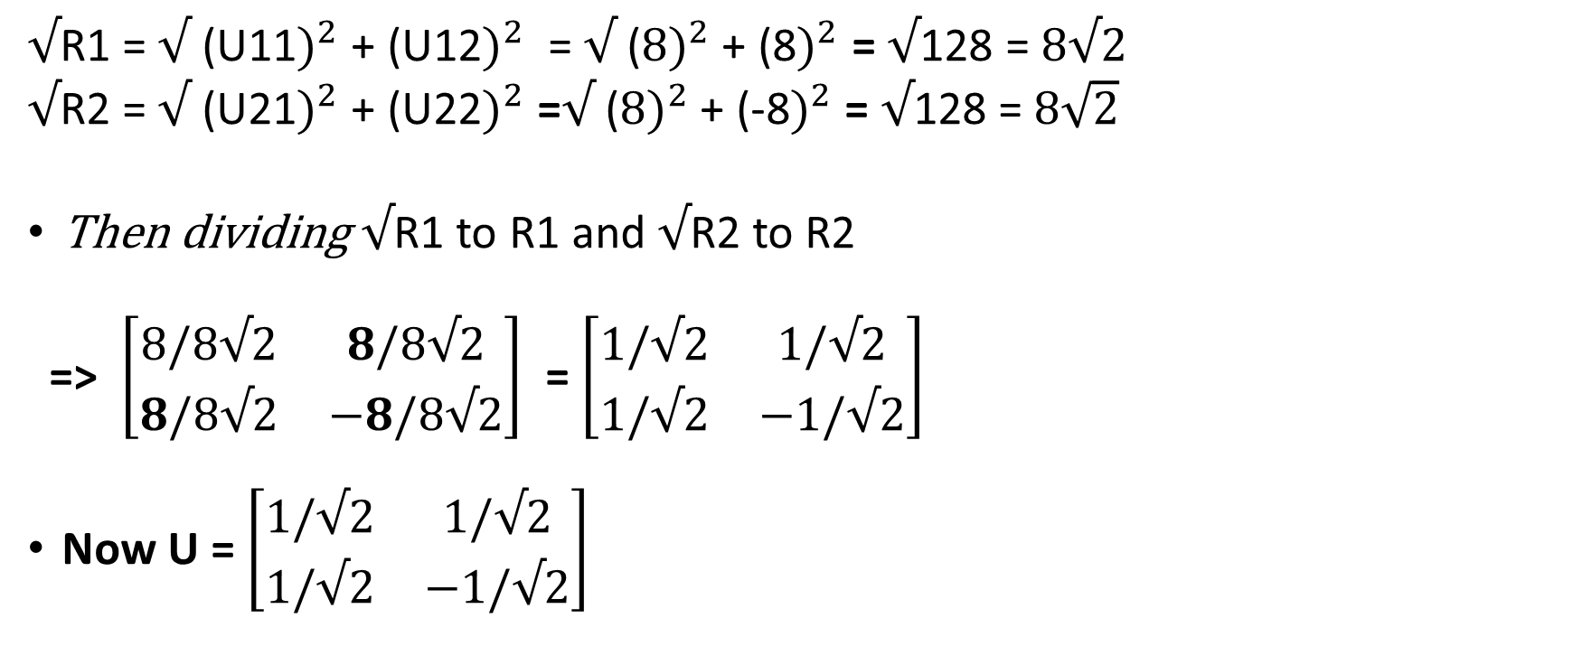
$√$R1 = $√$ (U11$)^{2}$+ (U12$)^{2}$ = $√$ ($8)^{2}$+ (8$)^{2}$ = $√$128 = $8√2$
$√$R2 = $√$ (U21$)^{2}$+ (U22$)^{2}$ =$√$ ($8)^{2}$+ (-8$)^{2}$ = $√$128 = $8\sqrt{2}$
Then dividing $√$R1 to R1 and $√$R2 to R2
=> $\left[\begin{matrix}8/8√2 & 8/8√2 \\ 8/8√2 & −8/8√2\end{matrix}\right]$ = $\left[\begin{matrix}1/√2 & 1/√2 \\ 1/√2 & −1/√2\end{matrix}\right]$
Now U = $\left[\begin{matrix}1/√2 & 1/√2 \\ 1/√2 & −1/√2\end{matrix}\right]$

Slide 23
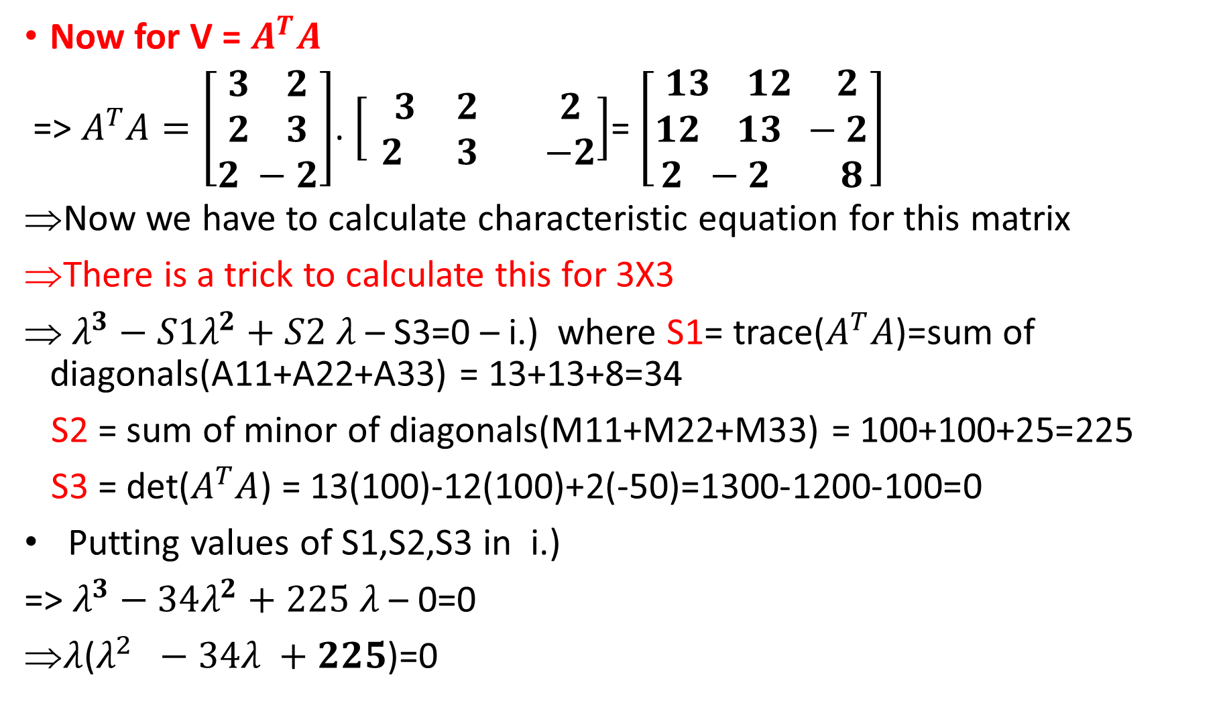
Now for V = $A^{T}A$
=> $A^{T}A=\left[\begin{aligned}3 2 \\ 2 3 \\ 2 −2\end{aligned}\right]$. $\left[\begin{matrix} 3 & 2 & 2 \\ 2 & 3 & −2\end{matrix}\right]$= $\left[\begin{aligned}13 12 2 \\ 12 13 −2 \\ 2 −2 8\end{aligned}\right]$
Now we have to calculate characteristic equation for this matrix
There is a trick to calculate this for 3X3
$λ^{3}−S1λ^{2}+S2$ $λ$ – S3=0 – i.) where S1= trace($A^{T}A$)=sum of diagonals(A11+A22+A33) = 13+13+8=34
S2 = sum of minor of diagonals(M11+M22+M33) = 100+100+25=225
S3 = det($A^{T}A$) = 13(100)-12(100)+2(-50)=1300-1200-100=0
Putting values of S1,S2,S3 in i.)
=> $λ^{3}−34λ^{2}+225$ $λ$ – 0=0
$λ$($λ^{2} −34λ +225$)=0

Slide 24
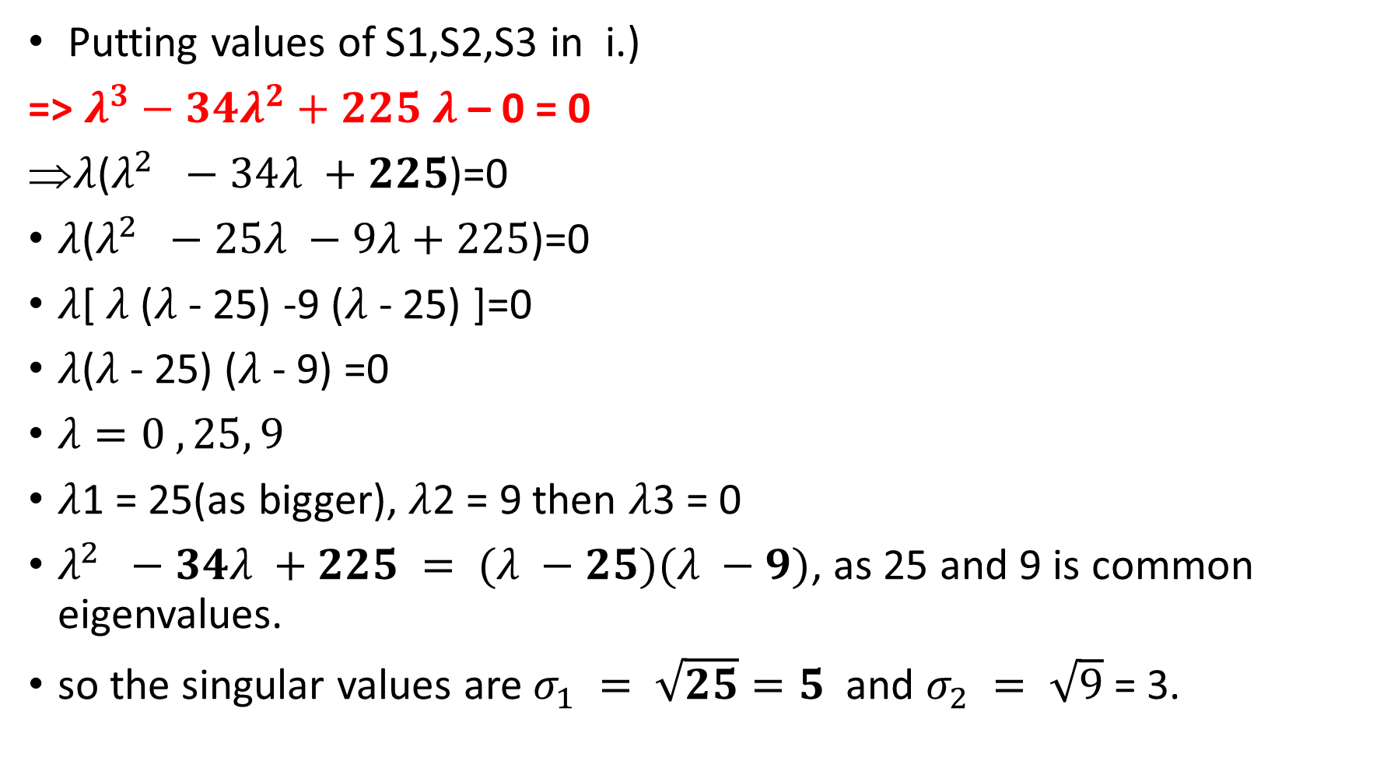
Putting values of S1,S2,S3 in i.)
=> $λ^{3}−34λ^{2}+225$ $λ$ – 0 = 0
$λ$($λ^{2} −34λ +225$)=0
$λ$($λ^{2} −25λ −9λ+225$)=0
$λ$[ $λ$($λ$- 25) -9 ($λ$- 25) ]=0
$λ$($λ$- 25) ($λ$- 9) =0
$λ=0 ,25, 9$
$λ$1 = 25(as bigger), $λ$2 = 9 then $λ$3 = 0
$λ^{2} −34λ +225 = (λ −25)(λ −9)$, as 25 and 9 is common eigenvalues.
so the singular values are $σ_{1} = \sqrt{25}=5$and $σ_{2} = \sqrt{9}$= 3.

Slide 25
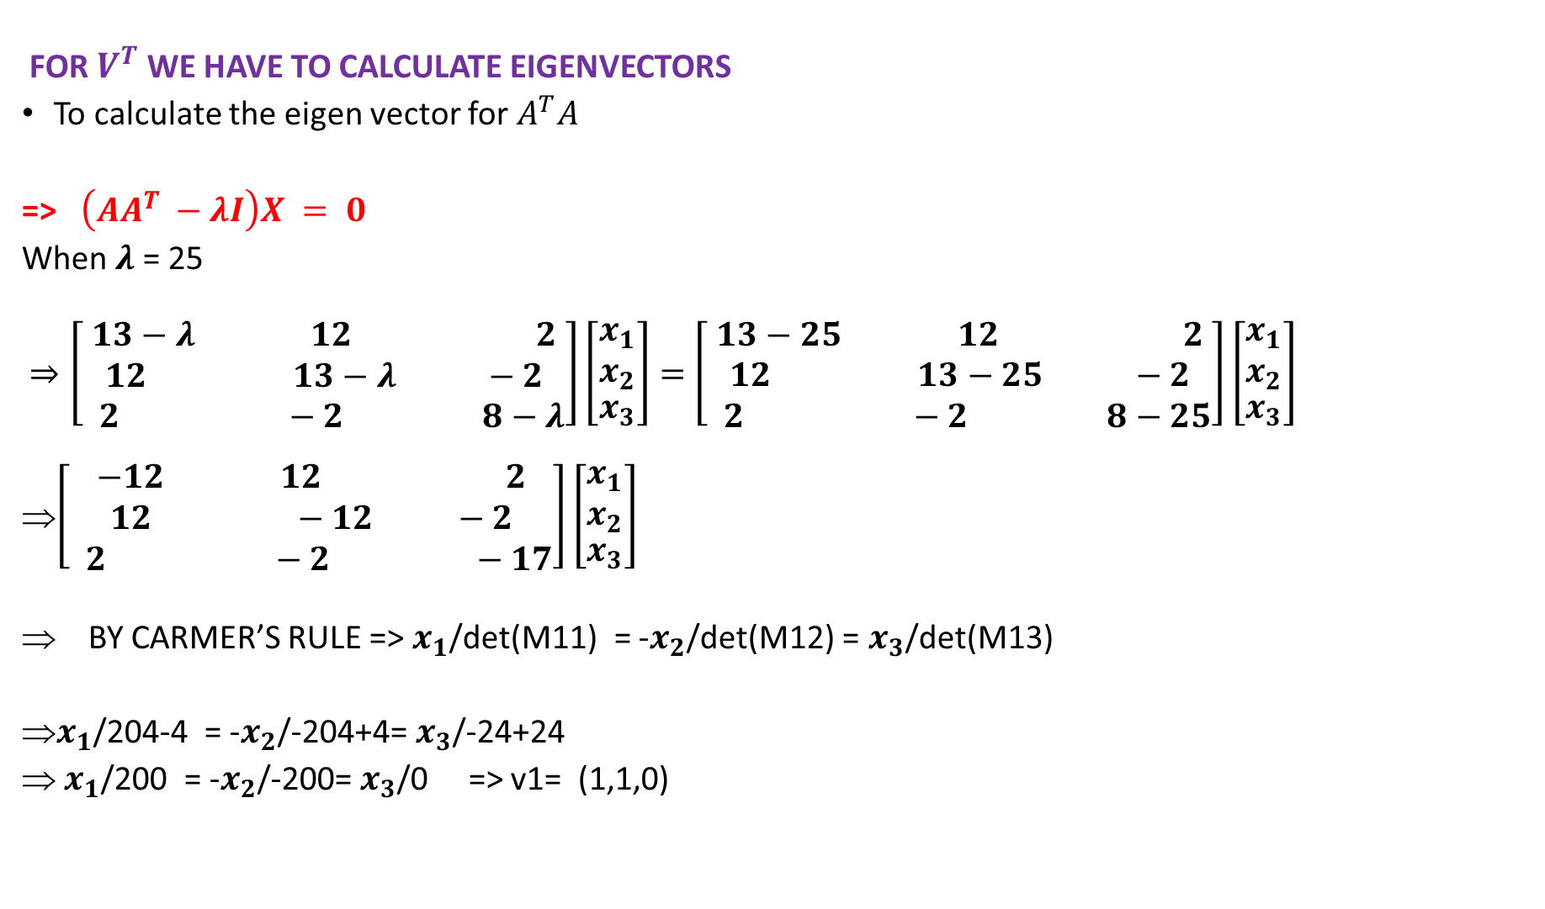
FOR $V^{T}$ WE HAVE TO CALCULATE EIGENVECTORS
To calculate the eigen vector for $A^{T}A$
=> $\left(AA^{T} −λI\right)X = 0$
When $λ$ = 25
$⇒\left[\begin{aligned}13−λ 12 2 \\ 12 13−λ −2 \\ 2 −2 8−λ\end{aligned}\right]\left[\begin{aligned}\begin{matrix}x_{1} \\ x_{2}\end{matrix} \\ x_{3}\end{aligned}\right]=$ $\left[\begin{aligned}13−25 12 2 \\ 12 13−25 −2 \\ 2 −2 8−25\end{aligned}\right]\left[\begin{aligned}\begin{matrix}x_{1} \\ x_{2}\end{matrix} \\ x_{3}\end{aligned}\right]$
$\left[\begin{aligned}−12 12 2 \\ 12 −12 −2 \\ 2 −2 −17\end{aligned}\right]\left[\begin{aligned}\begin{matrix}x_{1} \\ x_{2}\end{matrix} \\ x_{3}\end{aligned}\right]$
BY CARMER’S RULE => $x_{1}$/det(M11) = -$x_{2}$/det(M12) = $x_{3}$/det(M13)
$x_{1}$/204-4 = -$x_{2}$/-204+4= $x_{3}$/-24+24
$x_{1}$/200 = -$x_{2}$/-200= $x_{3}$/0 => v1= (1,1,0)

Slide 26
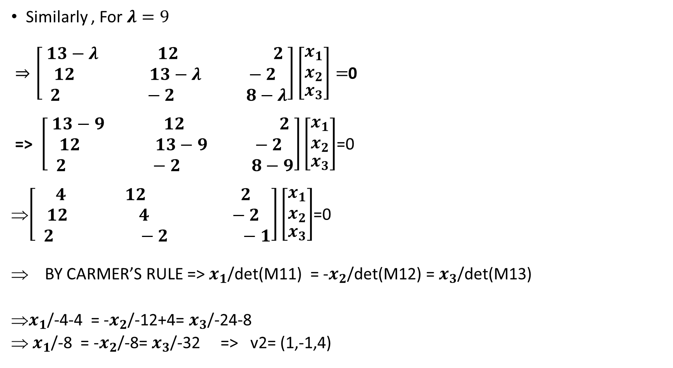
Similarly , For $λ=9$
$⇒\left[\begin{aligned}13−λ 12 2 \\ 12 13−λ −2 \\ 2 −2 8−λ\end{aligned}\right]\left[\begin{aligned}\begin{matrix}x_{1} \\ x_{2}\end{matrix} \\ x_{3}\end{aligned}\right]=$0
=> $\left[\begin{aligned}13−9 12 2 \\ 12 13−9 −2 \\ 2 −2 8−9\end{aligned}\right]\left[\begin{aligned}\begin{matrix}x_{1} \\ x_{2}\end{matrix} \\ x_{3}\end{aligned}\right]$=0
$\left[\begin{aligned}4 12 2 \\ 12 4 −2 \\ 2 −2 −1\end{aligned}\right]\left[\begin{aligned}\begin{matrix}x_{1} \\ x_{2}\end{matrix} \\ x_{3}\end{aligned}\right]$=0
BY CARMER’S RULE => $x_{1}$/det(M11) = -$x_{2}$/det(M12) = $x_{3}$/det(M13)
$x_{1}$/-4-4 = -$x_{2}$/-12+4= $x_{3}$/-24-8
$x_{1}$/-8 = -$x_{2}$/-8= $x_{3}$/-32 => v2= (1,-1,4)

Slide 27
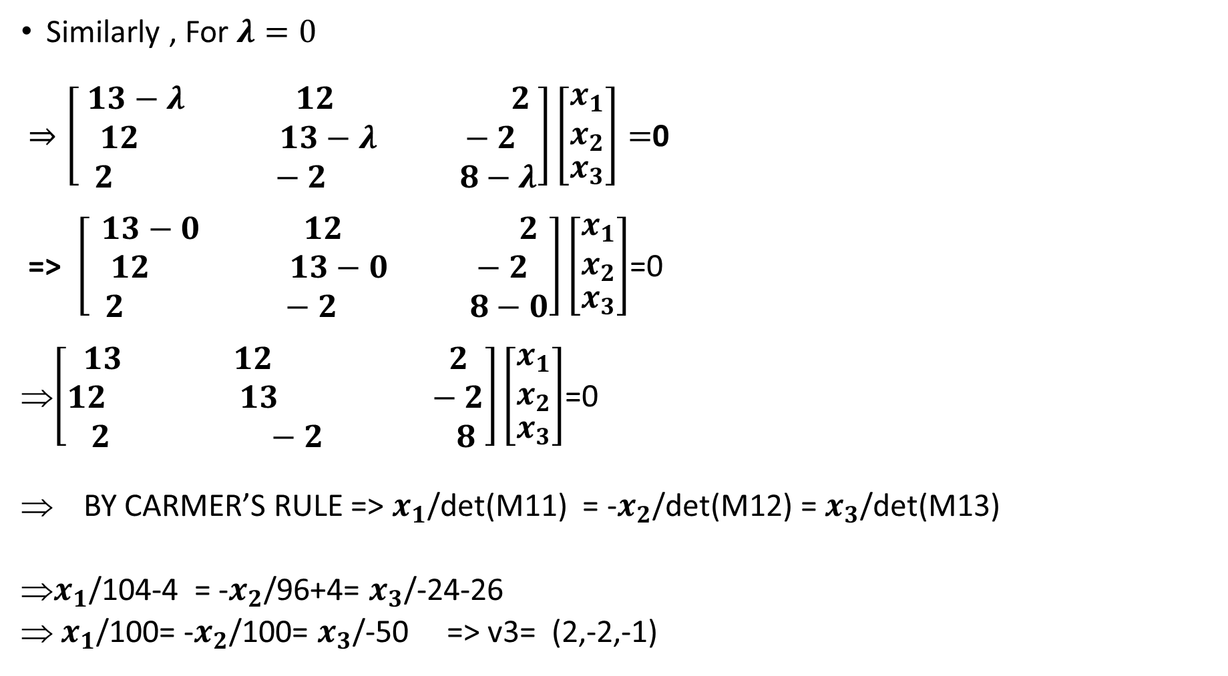
Similarly , For $λ=0$
$⇒\left[\begin{aligned}13−λ 12 2 \\ 12 13−λ −2 \\ 2 −2 8−λ\end{aligned}\right]\left[\begin{aligned}\begin{matrix}x_{1} \\ x_{2}\end{matrix} \\ x_{3}\end{aligned}\right]=$0
=> $\left[\begin{aligned}13−0 12 2 \\ 12 13−0 −2 \\ 2 −2 8−0\end{aligned}\right]\left[\begin{aligned}\begin{matrix}x_{1} \\ x_{2}\end{matrix} \\ x_{3}\end{aligned}\right]$=0
$\left[\begin{aligned}13 12 2 \\ 12 13 −2 \\ 2 −2 8\end{aligned}\right]\left[\begin{aligned}\begin{matrix}x_{1} \\ x_{2}\end{matrix} \\ x_{3}\end{aligned}\right]$=0
BY CARMER’S RULE => $x_{1}$/det(M11) = -$x_{2}$/det(M12) = $x_{3}$/det(M13)
$x_{1}$/104-4 = -$x_{2}$/96+4= $x_{3}$/-24-26
$x_{1}$/100= -$x_{2}$/100= $x_{3}$/-50 => v3= (2,-2,-1)

Slide 28
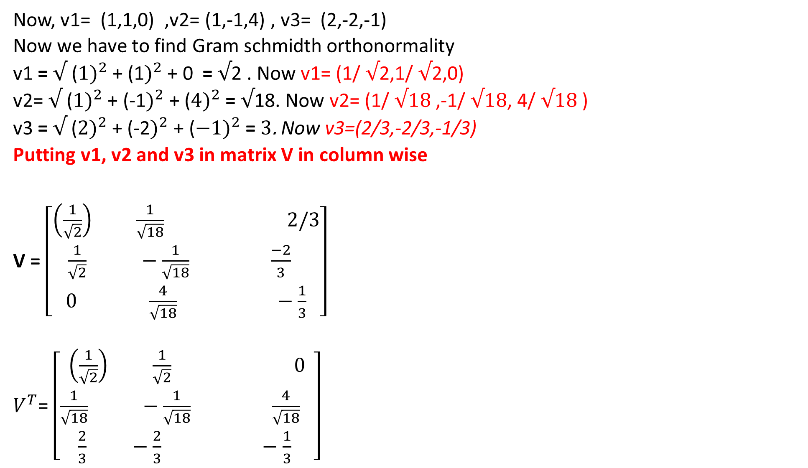
Now, v1= (1,1,0) ,v2= (1,-1,4) , v3= (2,-2,-1)
Now we have to find Gram schmidth orthonormality
v1 = $√$ ($1)^{2}$+ (1$)^{2}$ + 0 = $√$2 . Now v1= (1/ $√$2,1/ $√$2,0)
v2= $√$ ($1)^{2}$+ (-1$)^{2}$ + ($4)^{2}$ = $√$18. Now v2= (1/ $√18$ ,-1/ $√18$, 4/ $√18$ )
v3 =$√$ ($2)^{2}$+ (-2$)^{2}$ + ($−1)^{2}$ = $3$. Now v3=(2/3,-2/3,-1/3)
Putting v1, v2 and v3 in matrix V in column wise
V = $\left[\begin{aligned}\left(\frac{1}{\sqrt{2}}\right) \frac{1}{\sqrt{18}} 2/3 \\ \frac{1}{\sqrt{2}} −\frac{1}{\sqrt{18}} \frac{−2}{3} \\ 0 \frac{4}{\sqrt{18}} −\frac{1}{3}\end{aligned}\right]$
$V^{T}$= $\left[\begin{aligned}\left(\frac{1}{\sqrt{2}}\right) \frac{1}{\sqrt{2}} 0 \\ \frac{1}{\sqrt{18}} −\frac{1}{\sqrt{18}} \frac{4}{\sqrt{18}} \\ \frac{2}{3} −\frac{2}{3} −\frac{1}{3} \end{aligned}\right]$

Slide 29
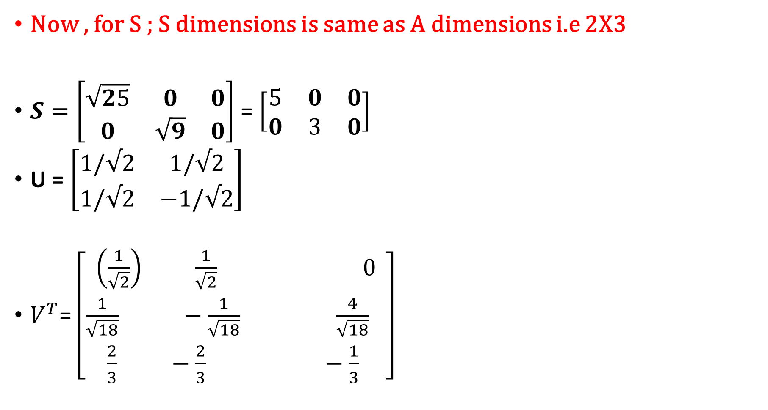
Now , for S ; S dimensions is same as A dimensions i.e 2X3
$S=\left[\begin{matrix}\sqrt{25} & 0 & 0 \\ 0 & \sqrt{9} & 0\end{matrix}\right]$ = $\left[\begin{matrix}5 & 0 & 0 \\ 0 & 3 & 0\end{matrix}\right]$
U = $\left[\begin{matrix}1/√2 & 1/√2 \\ 1/√2 & −1/√2\end{matrix}\right]$
$V^{T}$= $\left[\begin{aligned}\left(\frac{1}{\sqrt{2}}\right) \frac{1}{\sqrt{2}} 0 \\ \frac{1}{\sqrt{18}} −\frac{1}{\sqrt{18}} \frac{4}{\sqrt{18}} \\ \frac{2}{3} −\frac{2}{3} −\frac{1}{3} \end{aligned}\right]$

Slide 30
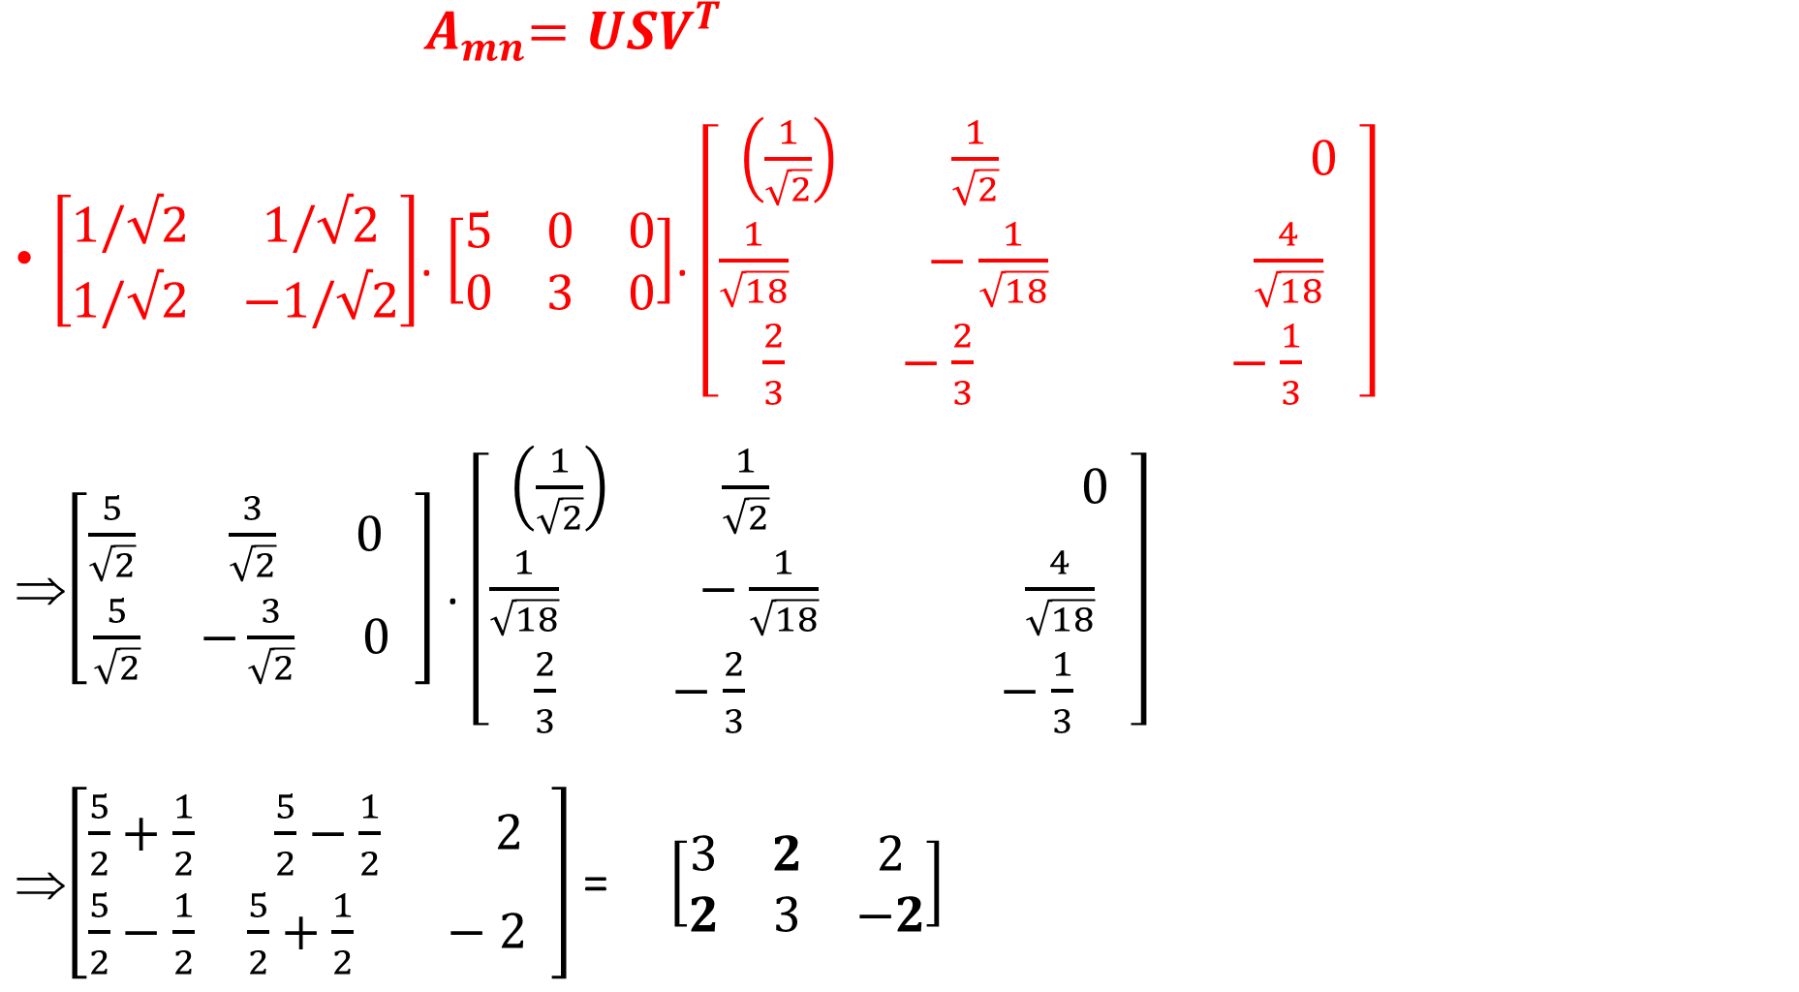
${ A}_{mn}=USV^{T}$
$\left[\begin{matrix}1/√2 & 1/√2 \\ 1/√2 & −1/√2\end{matrix}\right]$. $\left[\begin{matrix}5 & 0 & 0 \\ 0 & 3 & 0\end{matrix}\right]$. $\left[\begin{aligned}\left(\frac{1}{\sqrt{2}}\right) \frac{1}{\sqrt{2}} 0 \\ \frac{1}{\sqrt{18}} −\frac{1}{\sqrt{18}} \frac{4}{\sqrt{18}} \\ \frac{2}{3} −\frac{2}{3} −\frac{1}{3} \end{aligned}\right]$
$\left[\begin{matrix}\frac{5}{\sqrt{2}} & \frac{3}{\sqrt{2}} 0 \\ \frac{5}{\sqrt{2}} & −\frac{3}{\sqrt{2}} 0 \end{matrix}\right]$ . $\left[\begin{aligned}\left(\frac{1}{\sqrt{2}}\right) \frac{1}{\sqrt{2}} 0 \\ \frac{1}{\sqrt{18}} −\frac{1}{\sqrt{18}} \frac{4}{\sqrt{18}} \\ \frac{2}{3} −\frac{2}{3} −\frac{1}{3} \end{aligned}\right]$
$\left[\begin{matrix}\frac{5}{2}+\frac{1}{2} & \frac{5}{2}−\frac{1}{2} 2 \\ \frac{5}{2}−\frac{1}{2} & \frac{5}{2}+\frac{1}{2} −2 \end{matrix}\right]$ = $\left[\begin{matrix}3 & 2 & 2 \\ 2 & 3 & −2\end{matrix}\right]$

Slide 31
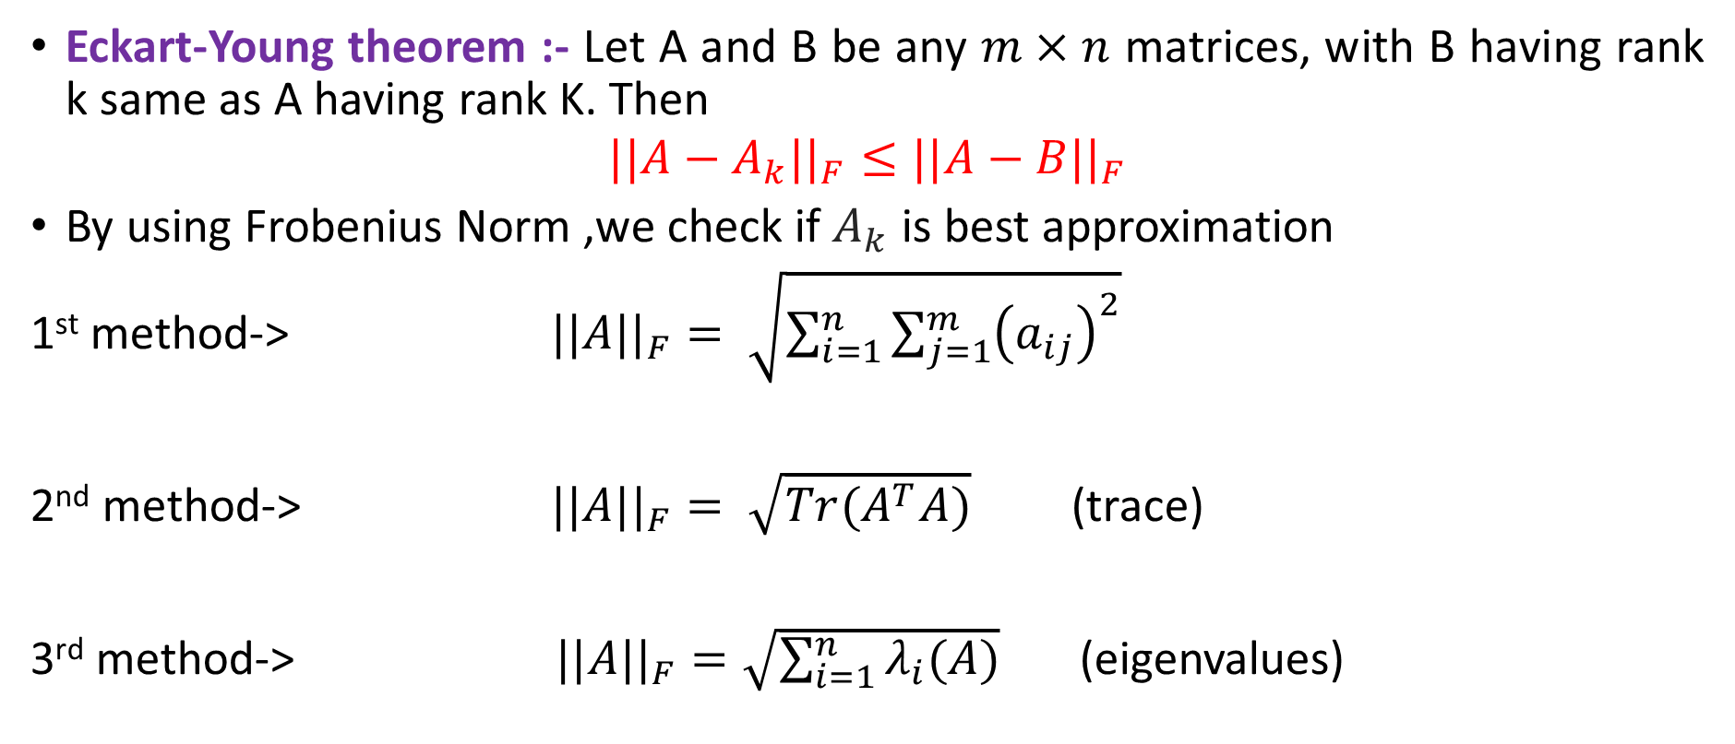

Best Rank-k approximations ($A_{k}$): Eckart-Young theorem
Eckart-Young theorem :- Let A and B be any $m×n$ matrices, with B having rank k same as A having rank K. Then
$$||A−A_{k}||_{F}≤||A−B||_{F}$$
By using Frobenius Norm ,we check if $A_{k}$ is best approximation
1st method-> $||A||_{F}= \sqrt{\sum_{i=1}^{n}{\sum_{j=1}^{m}{{\left(a_{ij}\right)}^{2}}}}$
2nd method-> $||A||_{F}= \sqrt{Tr(A^{T}A)}$(trace)
3rd method-> $||A||_{F}=\sqrt{\sum_{i=1}^{n}{λ_{i}(A)}}$ (eigenvalues)

Slide 32
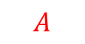


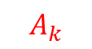
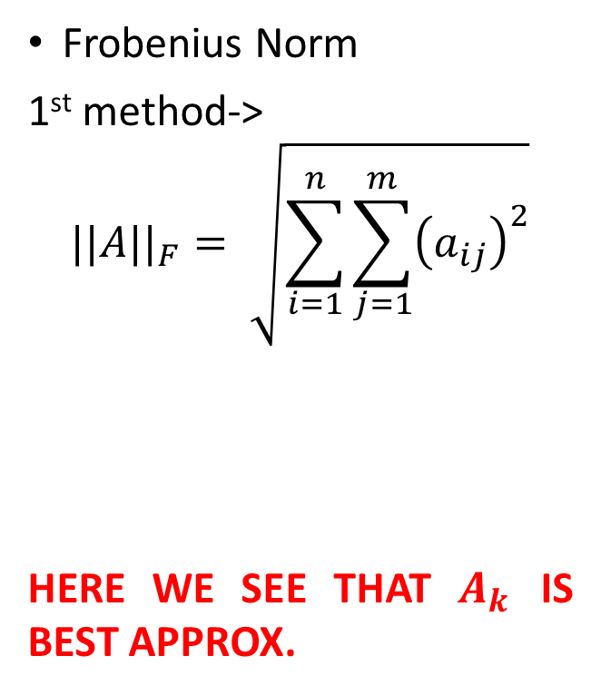
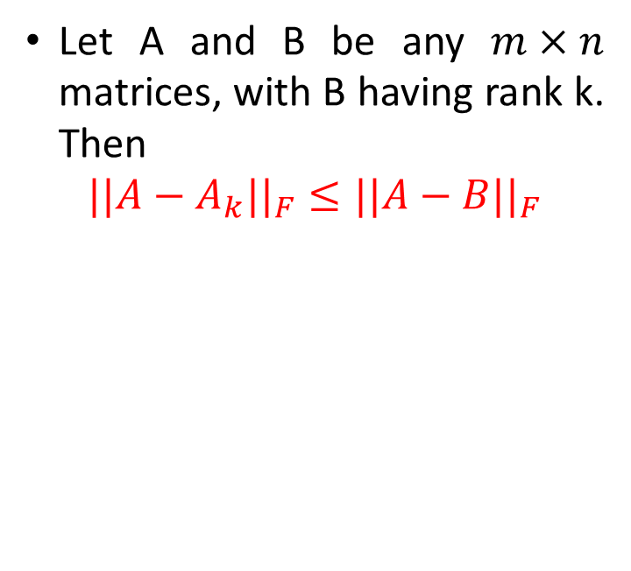
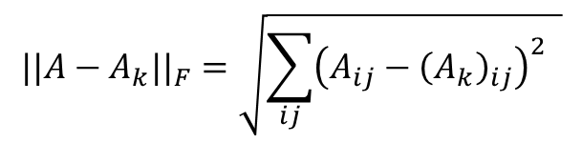
Best Rank-k approximations ($A_{k}$): Eckart-Young theorem
Frobenius Norm
1st method->
$$||A||_{F}= \sqrt{\sum_{i=1}^{n}{\sum_{j=1}^{m}{{\left(a_{ij}\right)}^{2}}}}$$
HERE WE SEE THAT $A_{k}$ IS BEST APPROX.
Let A and B be any $m×n$ matrices, with B having rank k. Then
$$||A−A_{k}||_{F}≤||A−B||_{F}$$
RANK 3
RANK 3
RANK 3
1 | 2 | 3
5 | 6 | 7
3 | 5 | 4
0 | 2 | 1
5 | 4 | 7
1 | 5 | 2
3 | 0 | 3
5 | 9 | 7
3 | 1 | 4
$$A$$
$$A_{k}$$
$$B$$
$$||A−A_{k}||_{F}=\sqrt{\sum_{ij}{{\left(A_{ij}−{\left(A_{k}\right)}_{ij}\right)}^{2} }}$$
$$=\sqrt{1^{2}+0^{2}+2^{2}+0^{2}+2^{2}+0^{2}+2^{2}+0^{2}+2^{2}}=\sqrt{17}=4.1231$$
$$||A−B||_{F}=\sqrt{\sum_{ij}{{\left(A_{ij}−B_{ij}\right)}^{2} }}=\sqrt{{\left(−2\right)}^{2}+2^{2}+0^{2}+0^{2}+{\left(−3\right)}^{2}+0^{2}+0^{2}+4^{2}+0^{2}}=\sqrt{33}=5.7446$$

Slide 33
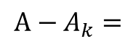

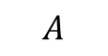
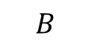
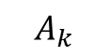
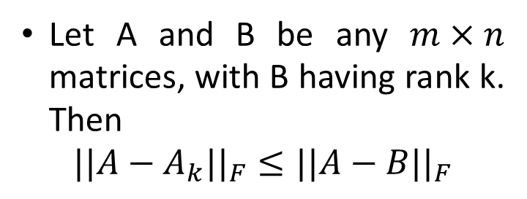
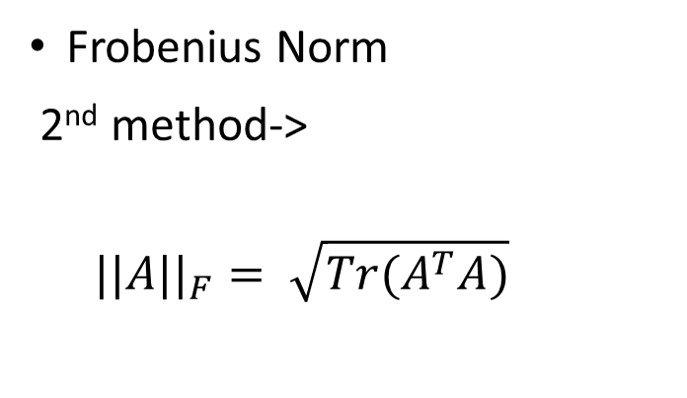
Best Rank-k approximations ($A_{k}$): Eckart-Young theorem
Frobenius Norm
2nd method->
$$||A||_{F}= \sqrt{Tr(A^{T}A)}$$
Let A and B be any $m×n$ matrices, with B having rank k. Then
$$||A−A_{k}||_{F}≤||A−B||_{F}$$
RANK 3
RANK 3
RANK 3
1 | 2 | 3
5 | 6 | 7
3 | 5 | 4
0 | 2 | 1
5 | 4 | 7
1 | 5 | 2
3 | 0 | 3
5 | 9 | 7
3 | 1 | 4
$$A$$
$$A_{k}$$
$$B$$
1 | 0 | 2
0 | 2 | 0
2 | 0 | 2
$$||A||_{F}= \sqrt{Tr( {\left(A−A_{k}\right)}^{T}\left(A−A_{k}\right))}$$
$$A−A_{k}=$$

Slide 34
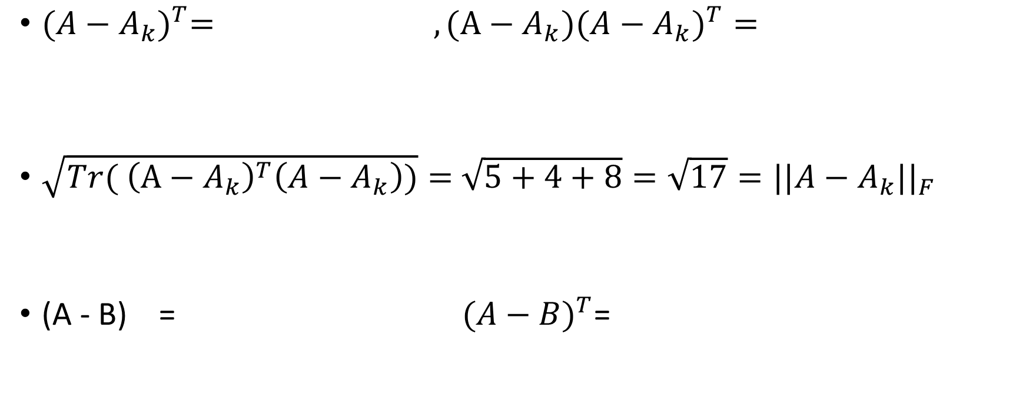
${(A−A_{k})}^{T}= , (A−A_{k}{)(A−A_{k})}^{T}=$
$\sqrt{Tr( {\left(A−A_{k}\right)}^{T}\left(A−A_{k}\right))}=$ $\sqrt{5+4+8}=\sqrt{17}=||A−A_{k}||_{F}$
(A - B) = ${ (A−B)}^{T}$=
1 | 0 | 2
0 | 2 | 0
2 | 0 | 2
5 | 0 | 5
0 | 4 | 0
6 | 0 | 8
-2 | 2 | 0
0 | -3 | 0
0 | 4 | 0
-2 | 0 | 0
2 | -3 | 4
0 | 0 | 0

Slide 35
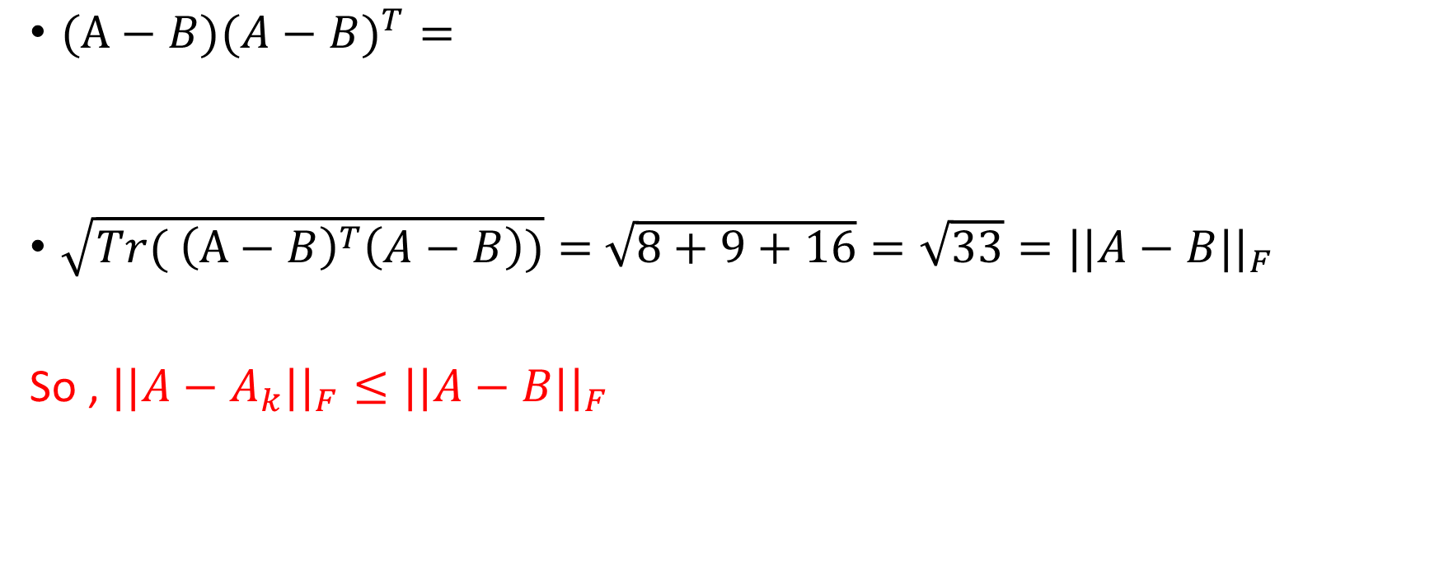
$(A−B{)(A−B)}^{T}=$
$\sqrt{Tr( {\left(A−B\right)}^{T}\left(A−B\right))}=$ $\sqrt{8+9+16}=\sqrt{33}=||A−B||_{F}$
So , $||A−A_{k}||_{F}≤||A−B||_{F}$
8 | -6 | 8
-6 | 9 | -12
8 | -12 | 16

Slide 36
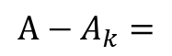

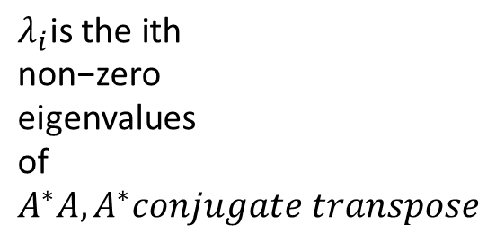
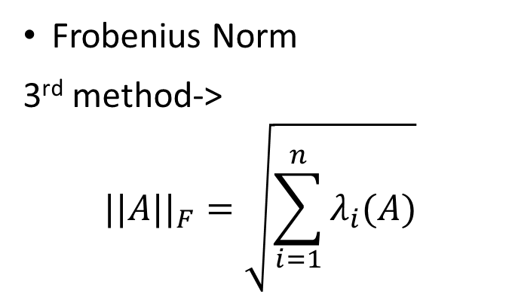

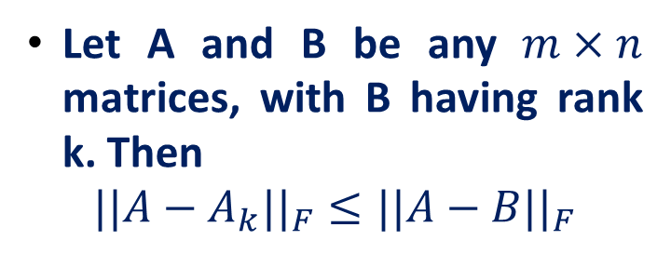
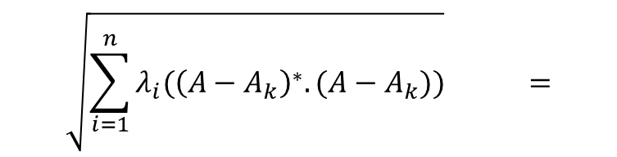
Best Rank-k approximations ($A_{k}$): Eckart-Young theorem
Frobenius Norm
3rd method->
$$||A||_{F}=\sqrt{\sum_{i=1}^{n}{λ_{i}(A)}}$$
Let A and B be any $m×n$ matrices, with B having rank k. Then
$$||A−A_{k}||_{F}≤||A−B||_{F}$$
RANK 3
RANK 3
RANK 3
1 | 2 | 3
5 | 6 | 7
3 | 5 | 4
0 | 2 | 1
5 | 4 | 7
1 | 5 | 2
3 | 0 | 3
5 | 9 | 7
3 | 1 | 4
$$λ_{i}\text{is} \text{the} \text{ith} \text{non}\text{−}\text{zero} \text{eigenvalues} \text{of} A^{∗}A, A^{∗}conjugate transpose$$
$$A$$
$$A_{k}$$
$$B$$
1 | 0 | 2
0 | 2 | 0
2 | 0 | 2
$$\sqrt{\sum_{i=1}^{n}{λ_{i}({\left(A−A_{k}\right)}^{∗}.(A−A_{k}))}} =$$
$$A−A_{k}=$$
$$||A−A_{k}||_{F}$$

Slide 37

For ${\left(A−A_{k}\right)}^{∗}$ we have to do conjugate transpose , as $A−A_{k}$ is real not has imaginary part so its conjugate transpose is simply a transpose
${(A−A_{k})}^{T}=$ , $(A−A_{k}{)(A−A_{k})}^{T}=$
$(A−A_{k}{)(A−A_{k})}^{T} so its eigenvalues is λ1=0.3153,λ2=4,λ3=12.687$
$\sqrt{\sum_{i=1}^{n}{λ_{i}({\left(A−A_{k}\right)}^{∗}.(A−A_{k}))}}$=$\sqrt{0.3153+4+12.6847}=\sqrt{17}$
1 | 0 | 2
0 | 2 | 0
2 | 0 | 2
5 | 0 | 6
0 | 4 | 0
6 | 0 | 8

Slide 38


Best Rank-k approximations ($A_{k}$): Eckart-Young theorem
Frobenius Norm
$$||A||_{F}^{2}=Tr(A^{T}A)$$
Let $A_{k}$ is the best rank-k approximation of A
$$||A−A_{k}||_{F}^{2}=Tr\left({\left(A−A_{k}\right)}^{T}\left(A−A_{k}\right)\right)$$
$$=Tr\left({\left(UΣV^{T}−UΣ_{k}V^{T}\right)}^{T}\left(UΣV^{T}−UΣ_{k}V^{T}\right)\right)$$
$$=Tr\left(\left(VΣU^{T}−VΣ_{k}U^{T}\right)\left(UΣV^{T}−UΣ_{k}V^{T}\right)\right)$$
$$=Tr\left(\left(VΣ−VΣ_{k}\right)U^{T}U\left(ΣV^{T}−Σ_{k}V^{T}\right)\right)$$
$$=Tr\left(V\left(Σ−Σ_{k}\right)\left(Σ−Σ_{k}\right)V^{T}\right)$$
$$=Tr\left(VV^{T}\left(Σ−Σ_{k}\right)\left(Σ−Σ_{k}\right)\right)$$
$$=\sum_{i=k+1}^{n}{λ_{i}(A)}$$

Slide 39
- Sawan
Kumar
Python Implementations for :
Geometrical Analysis
Finding SVD
Image Processing
Plotting graphs for Singular Values

Slide 40
Python Code for geometrical implementation
theta = np.array([np.pi/15, -np.pi/9, -np.pi/20]) Sigma = np.diag([3, 1, 0.5]) # scale x, then y, then z # Rotation about x axis Rx = np.array([[1, 0, 0], [0, np.cos(theta[0]), -np.sin(theta[0])], [0, np.sin(theta[0]), np.cos(theta[0])]]) # Rotation about y axis Ry = np.array([[np.cos(theta[1]), 0, np.sin(theta[1])], [0, 1, 0], [-np.sin(theta[1]), 0, np.cos(theta[1])]]) # Rotation about z axis Rz = np.array([[np.cos(theta[2]), -np.sin(theta[2]), 0], [np.sin(theta[2]), np.cos(theta[2]), 0], [0, 0, 1]]) # Rotate and scale X = Rz @ Ry @ Rx @ Sigma

Slide 41

Scaling

Slide 42

Rotations

Slide 43

Combinations of scaling and rotation

Slide 44

Removing 1 dimension

Slide 45

Removing 2 dimensions

Slide 46

SVD calculation in Python
from numpy import array from scipy.linalg import svd # define a matrix A = array([[1, 2], [3, 4], [5, 6]]) print(A) # SVD U, s, VT = svd(A) print("U is :\n", U) print("s is :\n", s) print("VT is :\n", VT)

Slide 47


Image Processing
An image is an array, or a matrix, of square pixels (picture elements) arranged in columns and rows.
In a (8-bit) greyscale image each picture element has an assigned intensity that ranges from 0 to 255.
A true-colour image assembled from three greyscale images coloured red, green and blue. Such an image may contain up to 16 million different colours.

Slide 48
Image compression using python
U, s, VT = np.linalg.svd(x, full_matrices= False) S = np.diag(s) j = 0 for r in range(5,100,20): Xapprox = U[:,:r] @ S[0:r,:r] @ VT[:r,:] plt.figure(j+1) j += 1 img = plt.imshow(Xapprox) img.set_cmap('gray') plt.axis('off') plt.title('r=' + str(r)) plt.show()

Slide 49

Image comparison after compression
Original image in grayscale

Slide 50


Slide 51


Slide 52


Slide 53


Slide 54


Slide 55


Slide 56
Singular Value graph plotting
Python Code :
from matplotlib.image import imread import matplotlib.pyplot as plt import numpy as np plt.rcParams['figure.figsize'] = [16, 8] A = imread('lion.jpg') x = np.mean(A, -1) U, s, VT = np.linalg.svd(x, full_matrices= False) S = np.diag(s) plt.figure(1) plt.semilogy(np.diag(S)) plt.title('Singular Values ') plt.xlabel("j") plt.ylabel("log \u03C3j") plt.show()

Slide 57

Singular Value graph

Slide 58
Cumulative Singular values graph plotting
Python code:
from matplotlib.image import imread import matplotlib.pyplot as plt import numpy as np plt.rcParams['figure.figsize'] = [16, 8] A = imread('lion.jpg') x = np.mean(A, -1) U, s, VT = np.linalg.svd(x, full_matrices= False) S = np.diag(s) plt.figure(2) plt.plot(np.cumsum(np.diag(S))/np.sum(np.diag(S))) plt.title('Singular Values Cumulative Sum') plt.xlabel("j") plt.ylabel("( 1<=j<=r \u03A3 \u03C3j ) / ( 1<=j<=m \u03A3 \u03C3j )") plt.show()

Slide 59

Singular values cumulative sum graph

Slide 60
PSEUDO-INVERSE and POWER METHOD FOR COMPUTING SVD
-Shradha

Slide 61

PSEUDO-INVERSE
Not every matrix has an inverse, but every matrix has a pseudoinverse, even non-square matrix.
The pseudoinverse is the generalization of the matrix inverse
for square matrices to rectangular matrices where the number
of rows and columns are not equal.
If order of A is m X n ,then pseudoinverse of A has order n X m;
The pseudoinverse of a matrix can be determined easily from the SVD, namely:
$$A^{+}={(UΣV^{T})}^{−1}$$
$= {(V^{T})}^{−1}$ $Σ^{+}$ $U^{−1}$
$=V Σ^{+}$ $U^{T}$

Slide 62

Where, $Σ$=$\left[\begin{matrix}Σ_{11} & ⋯ & 0 \\ ⋮ & ⋱ & ⋮ \\ 0 & ⋯ & Σ_{nn} \end{matrix}\begin{matrix}0 & ⋯ & 0 \\ ⋮ & ⋱ & ⋮ \\ 0 & … & 0\end{matrix}\right]$ of order m X n
$Σ^{+}=\left[\begin{matrix}1/Σ_{11} & … & 0 \\ ⋮ & ⋱ & ⋮ \\ 0 & … & 1/Σ_{11} \\ 0 & … & 0 \\ ⋮ & ⋱ & ⋮ \\ 0 & … & 0\end{matrix}\right]$ of order n X m
$A_{mXn}$ = $U_{mXm}$ $Σ_{mXn}$ $V_{nXn}^{T}$
$A_{nXm}^{+}$= $V_{nXn}Σ_{nXm}^{+}U_{mXm}^{T}$

Slide 63

EXAMPLE OF PSUEDOINVERSE:
Let A = $\left[\begin{matrix}1 & 2 & 3 \\ 3 & 4 & 5\end{matrix}\right]$ , order is 2 X 3
After computing SVD, we get sigma as ;
$Σ$ = $\left[\begin{matrix}7.9763886 & 0 & 0 \\ 0 & 0.61418515 & 0\end{matrix}\right]$
$Σ^{+} = \left[\begin{matrix}\text{0.12537002} & \text{0} \\ \text{0} & 1.62817352 \\ \text{0} & 0\end{matrix}\right]$
$A^{+}= \left[\begin{matrix}\text{−1.16666667} & \text{0.66666667} \\ \text{−0.16666667} & \text{0.1666666}7 \\ \text{0.83333333} & −0.33333333\end{matrix}\right]$, order is 3 X 2

Slide 64

POWER METHOD for computing SVD
Given any matrix A, we find SVD of A and for that firstly, we find eigen values.
So, Power Method is a way to find the largest eigen value of any matrix.
The Algorithm for computing eigen values using power method is as follows:
Input: A square matrix A ∈ R n × n and a vector u (0) ∈ Rn,
Output: The largest eigenvalue λ1 and the associated eigenvector
for k = 1, 2, · · · (repeat until convergence) i.e . ${||u^{(k+1)}−u^{(k)}||}_{F}$≤$τ$
where , tau $(set it very small like 1e−2)$
$w^{(k)}$ = $A.u^{(k−1)}$, $u^{(k)}=\frac{w^{(k)}}{|\left|w^{\left(k\right)}\right||}, λ^{(k)}={(u}^{(k)})T (A.u^{\left(k\right)})$

Slide 65

Algorithm of Power Method

Slide 66

So, Let A = $\left[\begin{matrix}3 & 2 \\ 2 & 6\end{matrix}\right] , u^{(0)}=$ $\left[\begin{aligned}1 \\ 1\end{aligned}\right]$
$w^{(1)}=A.u^{(0)}$ = $\left[\begin{aligned}5 \\ 8\end{aligned}\right]$
$u^{(1)}=\frac{w^{(1)}}{|\left|w^{\left(1\right)}\right||}$ = $\frac{1}{9.434} \left[\begin{aligned}5 \\ 8\end{aligned}\right]$=$\left[\begin{matrix}0.5229 \\ 0.8479\end{matrix}\right]$
There is a major difference between $u^{(0)}$ and $u^{(1)}$
${||u^{(1)}−u^{(0)}||}_{F}$ = $\sqrt{{(0.5229−1)}^{2}+{(0.8479−1)}^{2}}$ = 0.5007
The second iteration ->
$w^{(2)}=A.u^{(1)}$ = $\left[\begin{matrix}3 & 2 \\ 2 & 6\end{matrix}\right] \left[\begin{matrix}0.5229 \\ 0.8479\end{matrix}\right]$ = $\left[\begin{matrix}3.2855 \\ 6.1472\end{matrix}\right]$
$u^{(2)}=\frac{w^{(2)}}{|\left|w^{\left(2\right)}\right||}$ = $\frac{1}{6.9701}\left[\begin{matrix}3.2855 \\ 6.1472\end{matrix}\right]$= $\left[\begin{matrix}0.4714 \\ 0.8819\end{matrix}\right]$

Slide 67

${||u^{(2)}−u^{(1)}||}_{F}$ = $\sqrt{{(0.4714−0.5229)}^{2}+{(0.8819−0.8479)}^{2}}$ = 0.0617
The third iteration ->
$w^{(3)}=A.u^{(2)}$ = $\left[\begin{matrix}3 & 2 \\ 2 & 6\end{matrix}\right] \left[\begin{matrix}0.4714 \\ 0.8819\end{matrix}\right]$ = $\left[\begin{matrix}3.1795 \\ 6.2342\end{matrix}\right]$
$u^{(3)}=\frac{w^{(3)}}{|\left|w^{\left(3\right)}\right||}$ = $\frac{1}{6.998}\left[\begin{matrix}3.1795 \\ 6.2342\end{matrix}\right]$= $\left[\begin{matrix}0.4543 \\ 0.8908\end{matrix}\right]$
${||u^{(3)}−u^{(2)}||}_{F}$ = $\sqrt{{(0.4543−0.4714)}^{2}+{(0.8908−0.8819)}^{2}}$ = 0.020
Following this procedure again for the fourth time,
$w^{(4)}=A.u^{(3)}$ = $\left[\begin{matrix}3 & 2 \\ 2 & 6\end{matrix}\right] \left[\begin{matrix}0.4543 \\ 0.8908\end{matrix}\right]$ = $\left[\begin{matrix}3.1445 \\ 6.2534\end{matrix}\right]$
$u^{(4)}=\frac{w^{(4)}}{|\left|w^{\left(4\right)}\right||}$ = $\frac{1}{6.994}\left[\begin{matrix}3.1445 \\ 6.2543\end{matrix}\right]$= $\left[\begin{matrix}0.4496 \\ 0.8941\end{matrix}\right]$

Slide 68

${||u^{(4)}−u^{(3)}||}_{F}$ = $\sqrt{{(0.4496−0.4543)}^{2}+{(0.8941−0.8908)}^{2}}$ = 0.0057 < $τ$
The convergence is obtained, so x = $\left[\begin{matrix}0.4496 \\ 0.8941\end{matrix}\right]$
Now, $λ^{(1)}$ = $x^{T}A x$
= $\left[0.4496 0.8941\right]$ $\left[\begin{matrix}3 & 2 \\ 2 & 6\end{matrix}\right]$ $\left[\begin{matrix}0.4496 \\ 0.8941\end{matrix}\right]$
= 7.0108, The required eigen value (approx. 7)
Determining $λ^{(2)}$,
A $=A−λ^{(1)}x$.$x^{T}$
A = $\left[\begin{matrix}3 & 2 \\ 2 & 6\end{matrix}\right] −7\left[\begin{aligned}0.4478 \\ 0.8942\end{aligned}\right]$ $\left[0.4478 0.8942\right]$
A = $\left[\begin{matrix} 1.593 & −0.803 \\ −0.803 & 0.403\end{matrix}\right]$

Slide 69

So, Let A = $\left[\begin{matrix} 1.593 & −0.803 \\ −0.803 & 0.403\end{matrix}\right]$ $, u^{(0)}=$ $\left[\begin{aligned}1 \\ 1\end{aligned}\right]$
$w^{(1)}=A.u^{(0)}$ = $\left[\begin{aligned}0.79 \\ −0.4\end{aligned}\right]$
$u^{(1)}=\frac{w^{(1)}}{|\left|w^{\left(1\right)}\right||}$ = $\frac{1}{0.8854} \left[\begin{aligned}0.79 \\ −0.4\end{aligned}\right]$=$\left[\begin{matrix}0.8922 \\ −0.4517\end{matrix}\right]$
There is a major difference between $u^{(0)}$ and $u^{(1)}$
${||u^{(1)}−u^{(0)}||}_{F}$ = $\sqrt{{(0.8992−1)}^{2}+{(−0.4517−1)}^{2}}$ = 1.4551
The second iteration ->
$w^{(2)}=A.u^{(1)}$ = $\left[\begin{matrix} 1.593 & −0.803 \\ −0.803 & 0.403\end{matrix}\right]\left[\begin{matrix}0.8922 \\ −0.4517\end{matrix}\right]$= $\left[\begin{matrix}1.7839 \\ −0.8984\end{matrix}\right]$
$u^{(2)}=\frac{w^{(2)}}{|\left|w^{\left(2\right)}\right||}$ = $\frac{1}{0.9973}\left[\begin{matrix}1.7839 \\ −0.8984\end{matrix}\right]$= $\left[\begin{matrix}1.7887 \\ −0.9008\end{matrix}\right]$
${||u^{(2)}−u^{(1)}||}_{F}$ = $\sqrt{{(1.7887−0.8922)}^{2}+{(−0.9008−\left(−0.4517\right))}^{2}}$ = 1.0026

Slide 70

The third iteration ->
$w^{(3)}=A.u^{(2)}$ = $\left[\begin{matrix} 1.593 & −0.803 \\ −0.803 & 0.403\end{matrix}\right]\left[\begin{matrix}1.7887 \\ −0.9008\end{matrix}\right]$ = $\left[\begin{matrix}3.5727 \\ −1.7993\end{matrix}\right]$
$u^{(3)}=\frac{w^{(3)}}{|\left|w^{\left(3\right)}\right||}$ = $\frac{1}{3.9973}\left[\begin{matrix}3.5727 \\ −1.7993\end{matrix}\right]$= $\left[\begin{matrix}0.8937 \\ −0.4501\end{matrix}\right]$
${||u^{(3)}−u^{(2)}||}_{F}$ = $\sqrt{{(0.8937−1.7887)}^{2}+{(−0.4501+0.9008)}^{2}}$ = 1.0020
Following this procedure again for the fourth time,
$w^{(4)}=A.u^{(3)}$ = $\left[\begin{matrix} 1.593 & −0.803 \\ −0.803 & 0.403\end{matrix}\right]\left[\begin{matrix}0.8937 \\ −0.4501\end{matrix}\right]$= $\left[\begin{matrix}1.785 \\ −0.8990\end{matrix}\right]$
$u^{(4)}=\frac{w^{(4)}}{|\left|w^{\left(4\right)}\right||}$ = $\frac{1}{1.9986}\left[\begin{matrix}1.785 \\ −0.8990\end{matrix}\right]$= $\left[\begin{matrix}0.8931 \\ −0.4498\end{matrix}\right]$
${||u^{(4)}−u^{(3)}||}_{F}$ = $\sqrt{{(0.8931−0.8937)}^{2}+{(−0.4498+0.4501)}^{2}}$ = 0.00067 < $τ$

Slide 71

The convergence is obtained, so x =$\left[\begin{matrix}0.8931 \\ −0.4498\end{matrix}\right]$
Now, $λ^{(2)}$ = $x^{T}A x$
= $\left[0. 8931 −0.4498\right]\left[\begin{matrix} 1.593 & −0.803 \\ −0.803 & 0.403\end{matrix}\right]\left[\begin{matrix}0.8931 \\ −0.4498\end{matrix}\right]$
= 1.9972, The required eigen value (approx. 2)
We got the desired eigen values as 7 and 2.

Slide 72
THANK YOU

